Slide 1
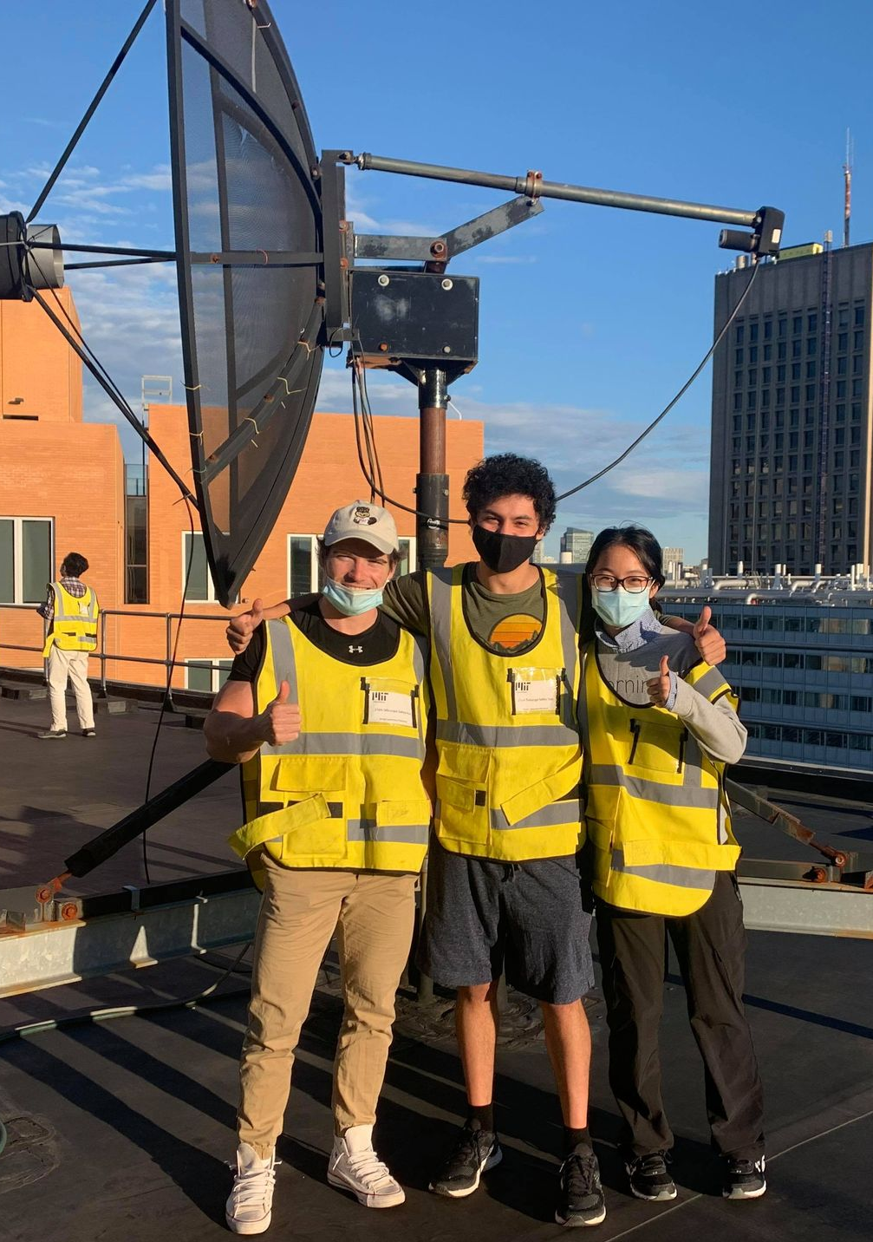
Galactic Geometry and the Rotation of the Milky Way
Octavio Vega
Tuesday, December 7, 2021
8.13 Experimental Physics 1 – Fall 2021

Slide 2
Experimental Goals
Derive a Rotation Curve of the Milky Way
Compare results with predictive models
i.e. classical models vs. newer models
What do they reveal?

Slide 3
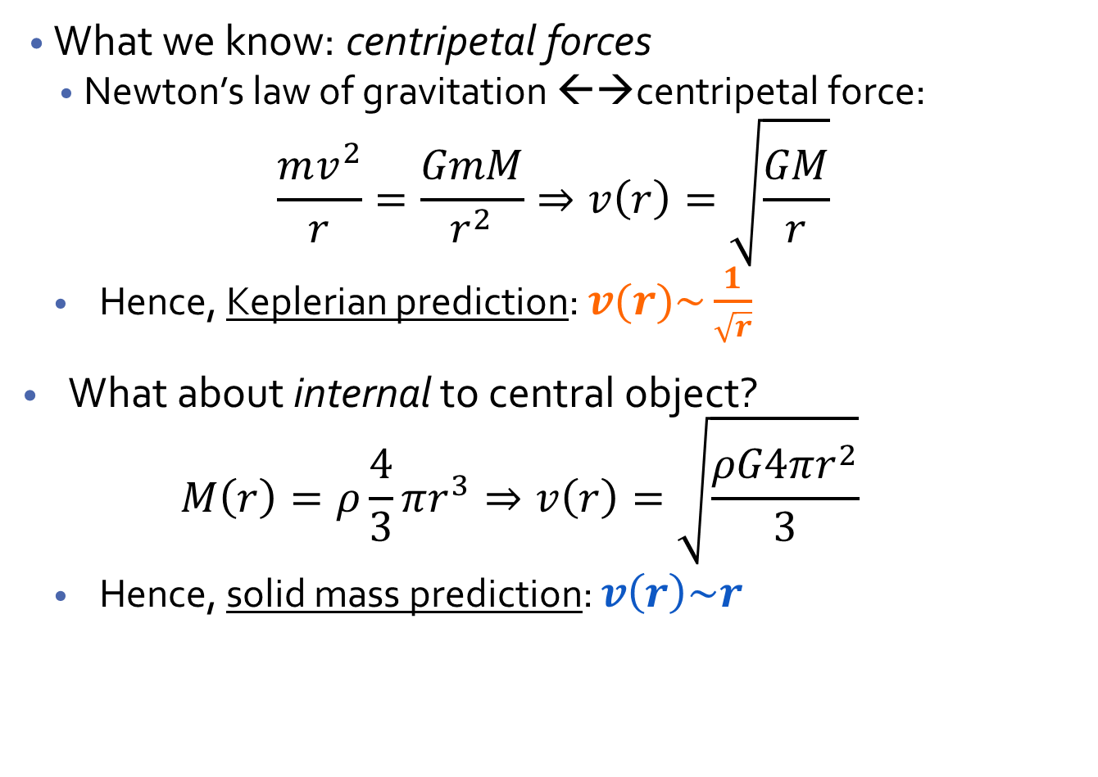
Theory of Gravitation and Rotation
What we know: centripetal forces
Newton’s law of gravitation ←→centripetal force:
$$\frac{mv^{2}}{r}=\frac{GmM}{r^{2}}⇒v\left(r\right)=\sqrt{\frac{GM}{r}}$$
Hence, Keplerian prediction: $v(r)\sim \frac{1}{\sqrt{r}}$
What about internal to central object?
$$M\left(r\right)=ρ\frac{4}{3}πr^{3}⇒v\left(r\right)=\sqrt{\frac{ρG4πr^{2}}{3}}$$
Hence, solid mass prediction: $v\left(r\right)\sim r$
m
r
M

Slide 4
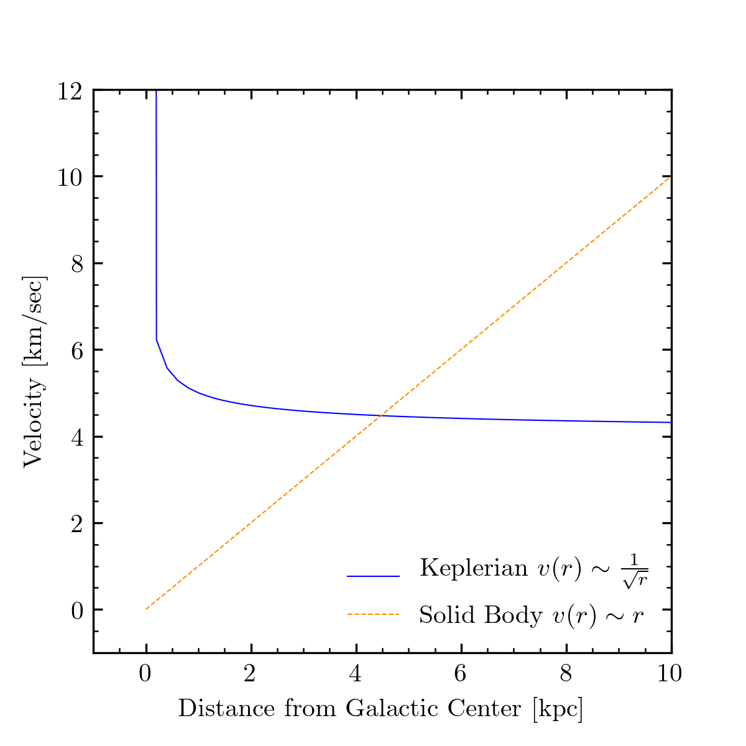
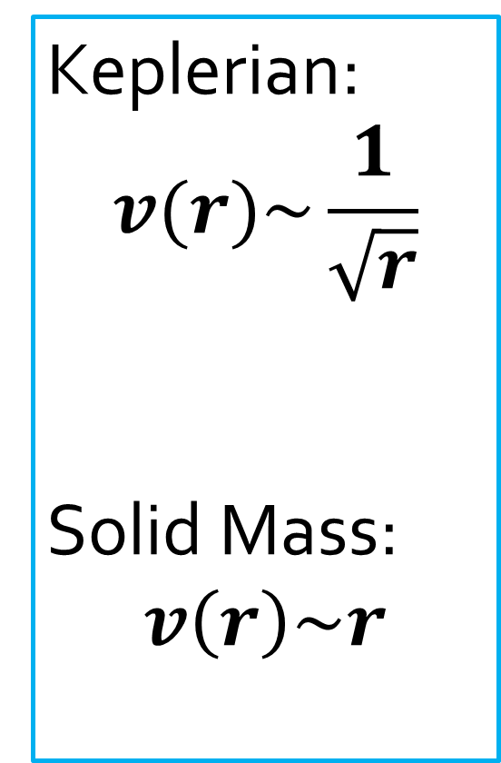
Theoretical Models of Rotation Curves
Keplerian:
$$v(r)\sim \frac{1}{\sqrt{r}}$$
Solid Mass:
$$v\left(r\right)\sim r$$

Slide 5
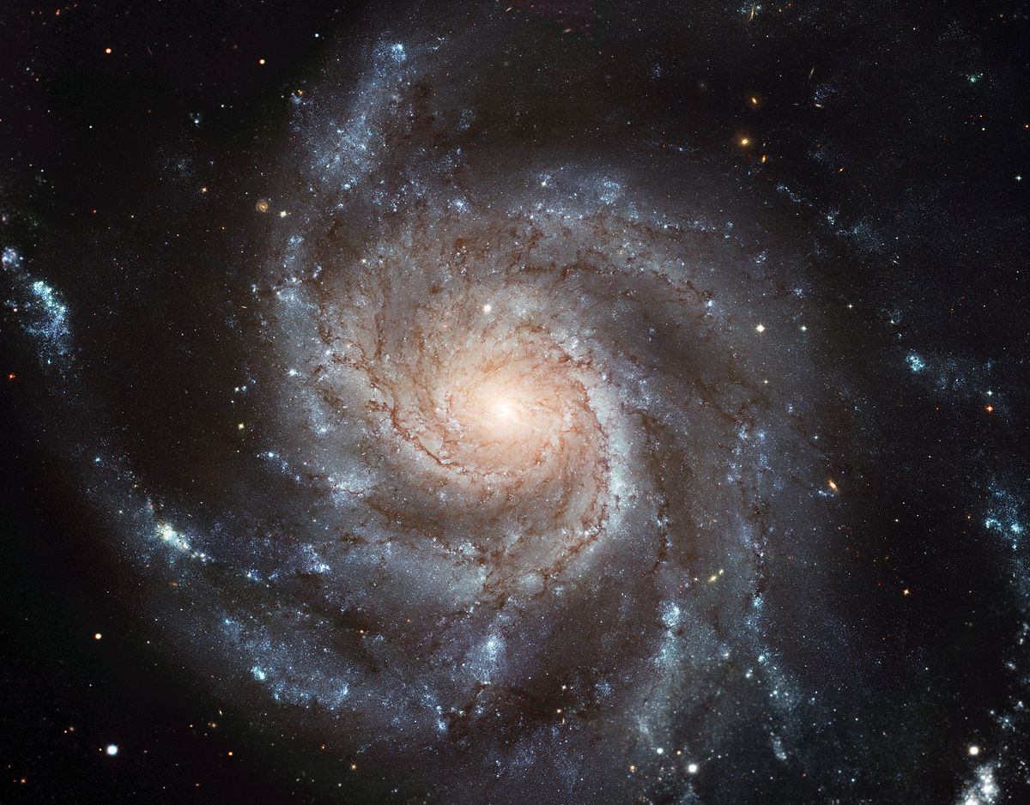

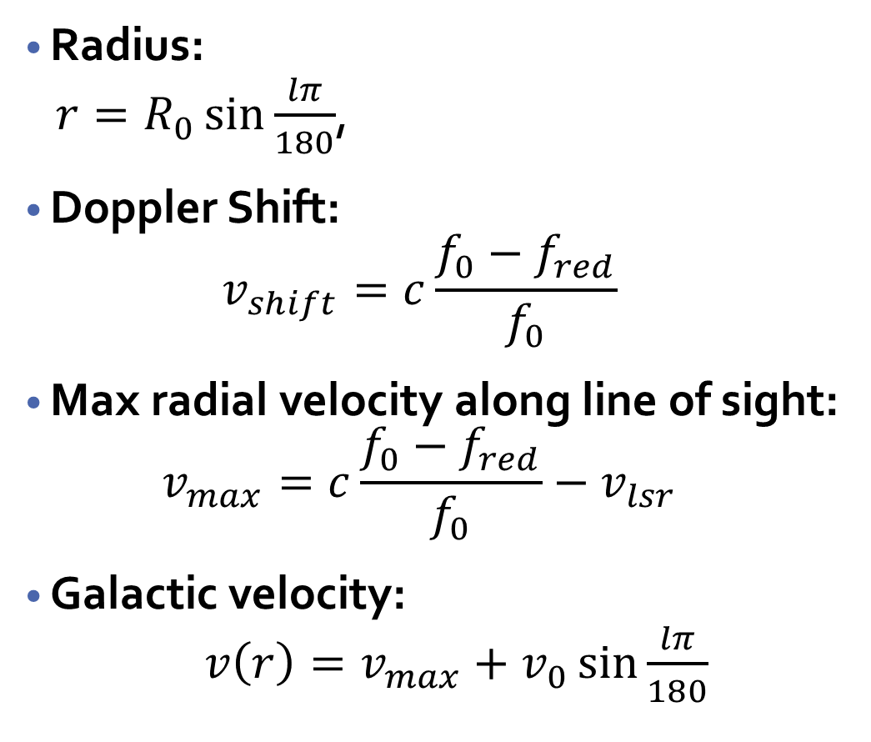



Computing Velocities – Geometry of the Galaxy
Radius:
$r=R_{0}\sin{\frac{lπ}{180}}$,
Doppler Shift:
$$v_{shift}=c\frac{f_{0}−f_{red}}{f_{0}}$$
Max radial velocity along line of sight:
$$v_{max}=c\frac{f_{0}−f_{red}}{f_{0}}−v_{lsr}$$
Galactic velocity:
$v\left(r\right)=v_{max}+v_{0}\sin{\frac{lπ}{180}}$
$$v_{0}$$
$$R_{0}$$
$$r$$
$$l$$

Slide 6
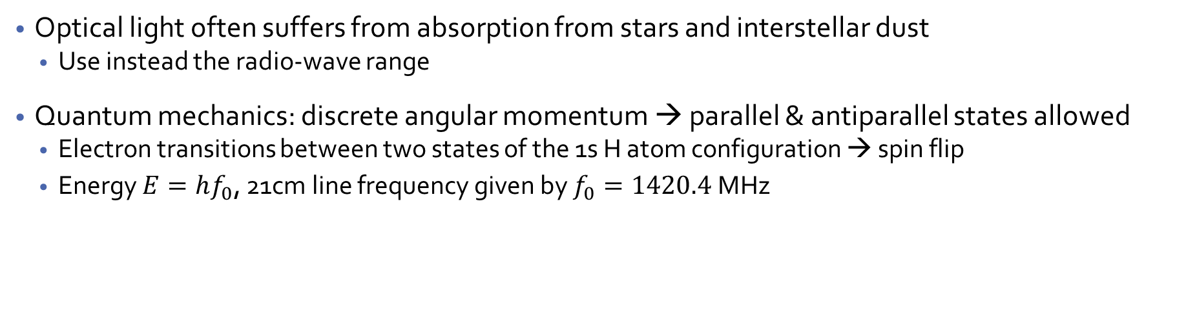
Theory of the 21cm Line of Hydrogen
Optical light often suffers from absorption from stars and interstellar dust
Use instead the radio-wave range
Quantum mechanics: discrete angular momentum → parallel & antiparallel states allowed
Electron transitions between two states of the 1s H atom configuration → spin flip
Energy $E=hf_{0}$, 21cm line frequency given by $f_{0}=1420.4$MHz

Slide 7
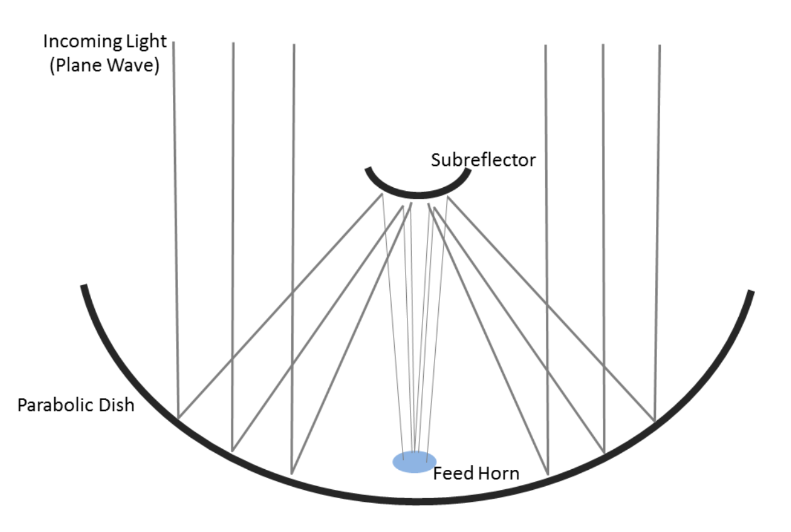
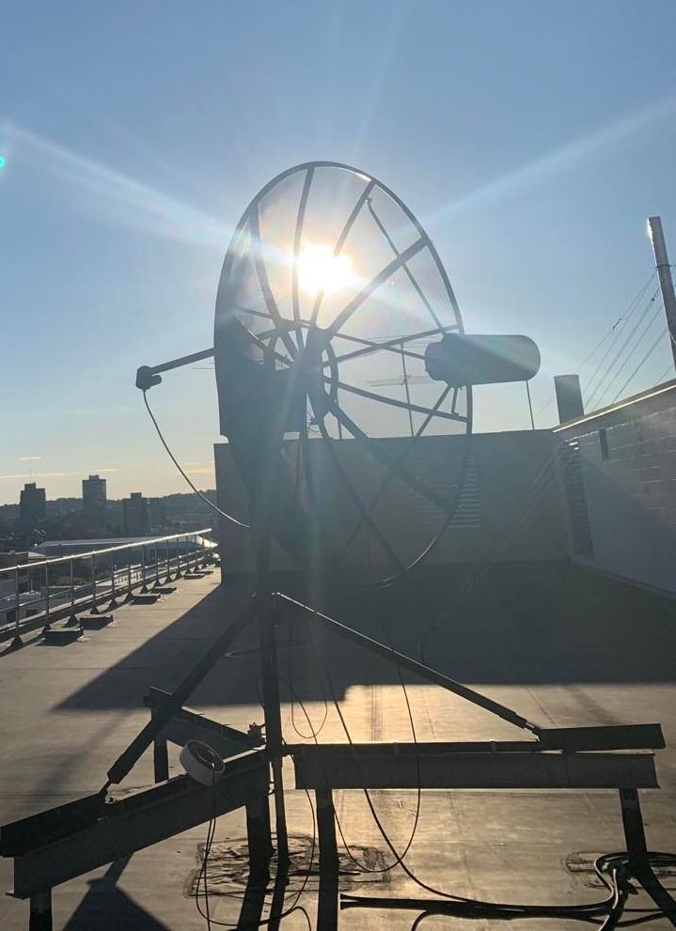
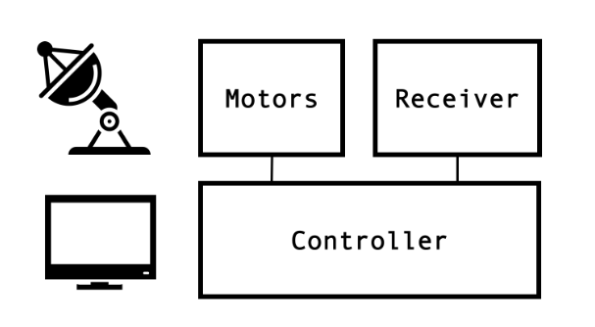
Small Radio Telescope (SRT) Apparatus
(See Appendix C for Circuitry )

Slide 8
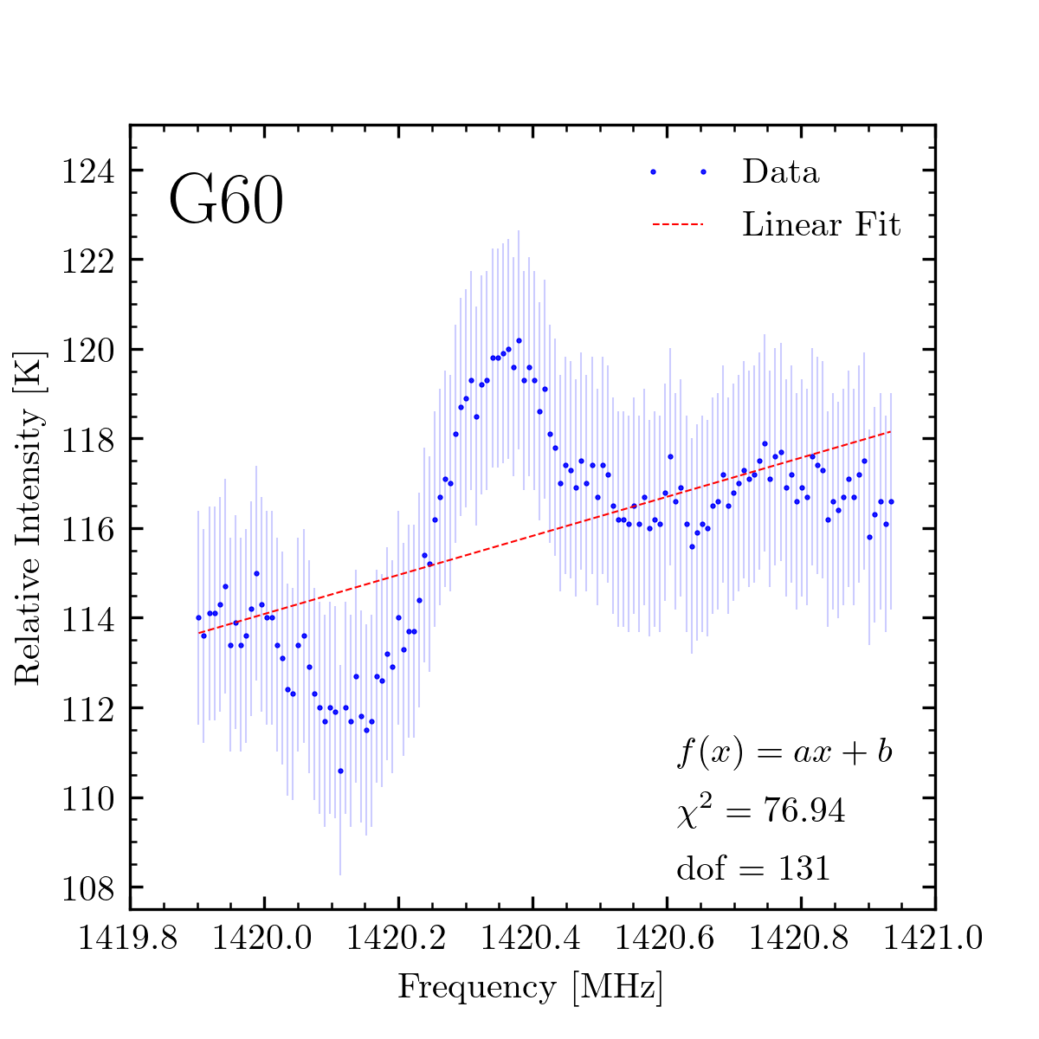
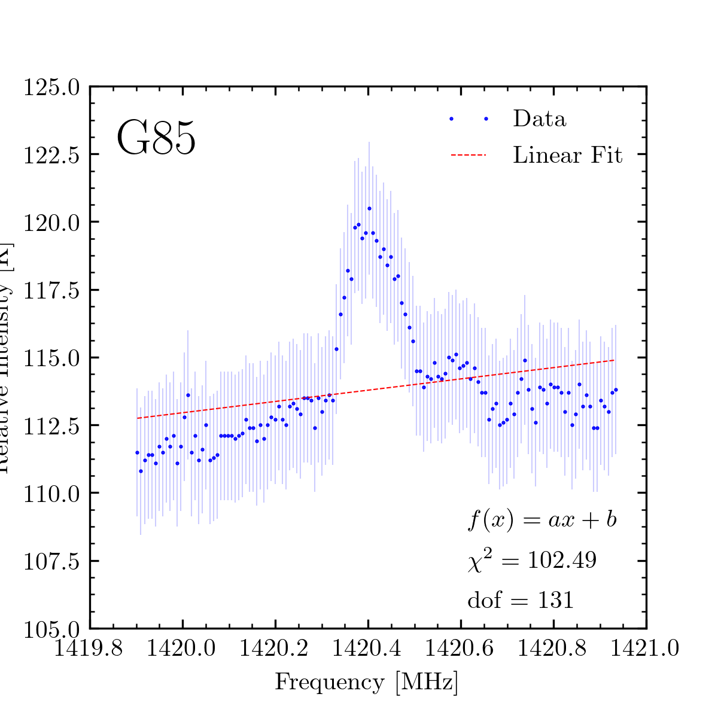
Intensity Spectra and Fitting to the Background

Slide 9
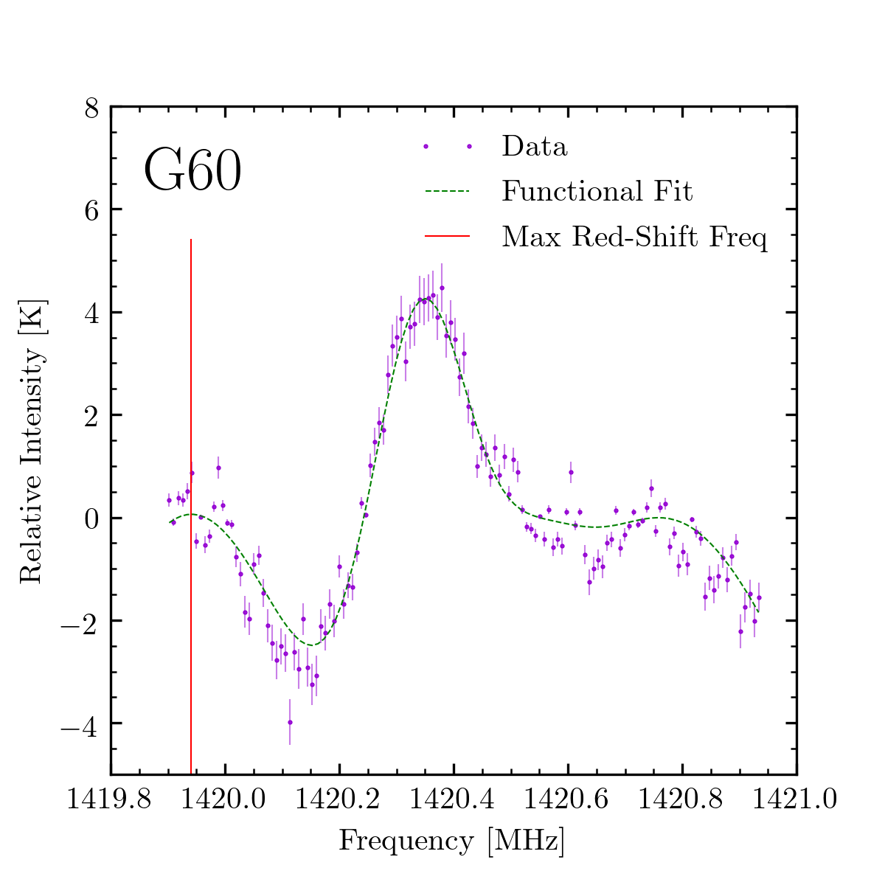
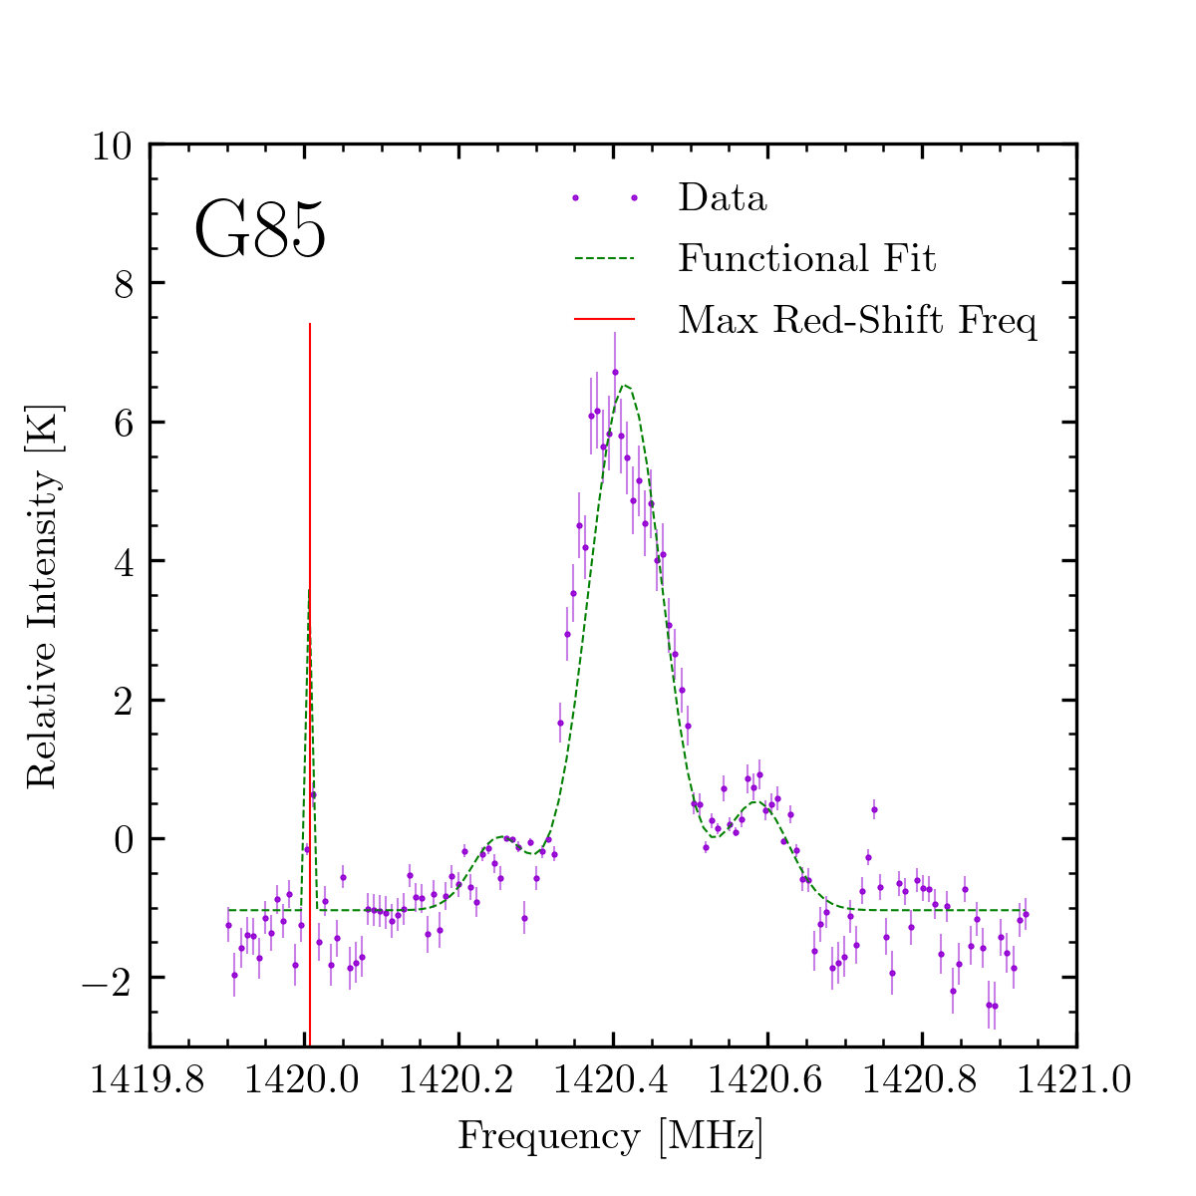
Background-Subtracted Fits to the Red Shift

Slide 10
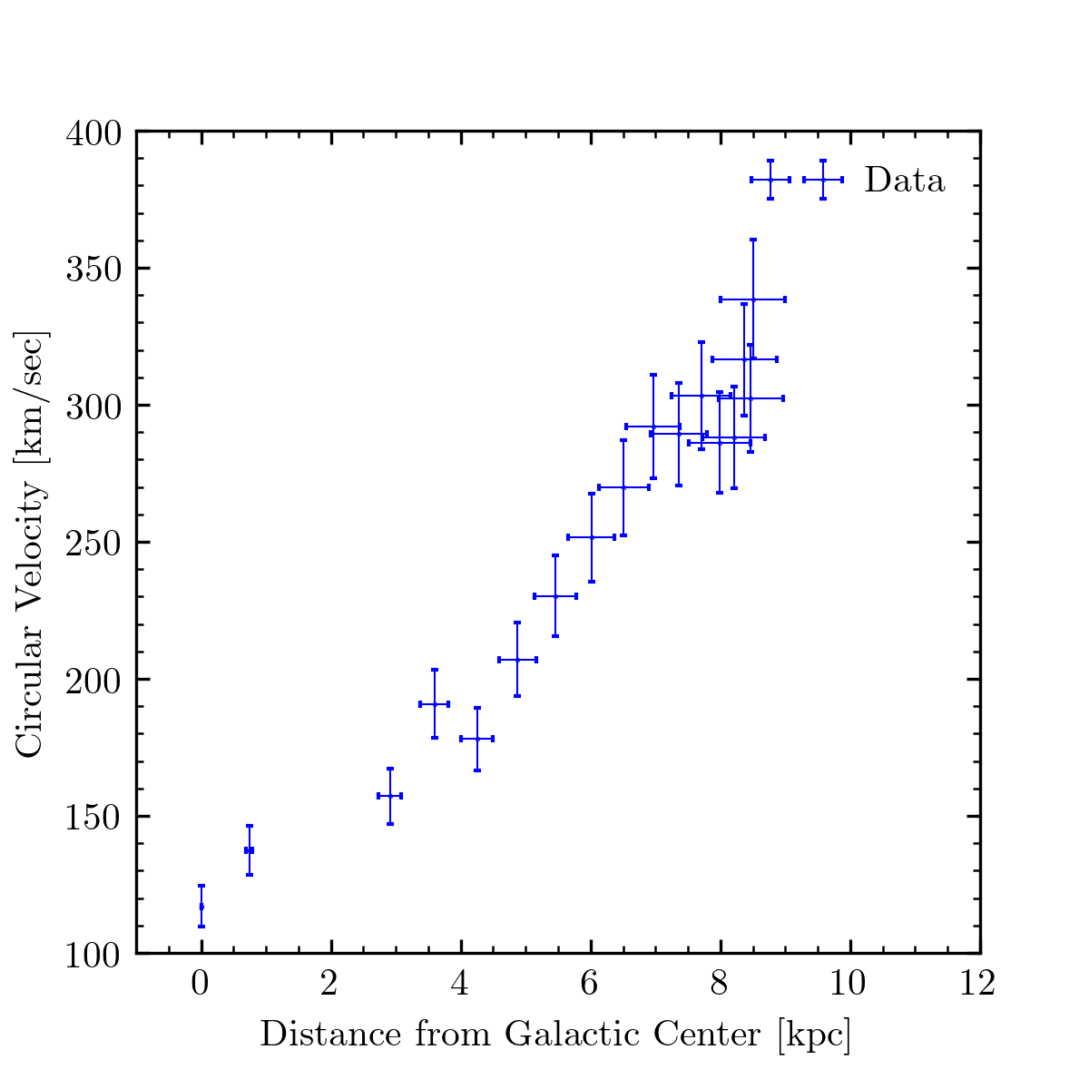
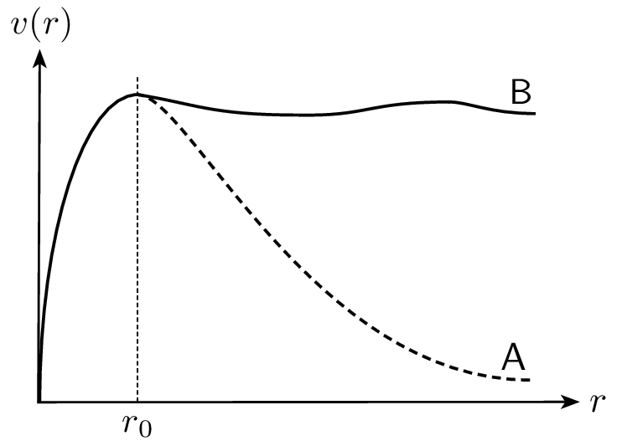
Comparing Our Rotation Curve with Other Observations

Slide 11
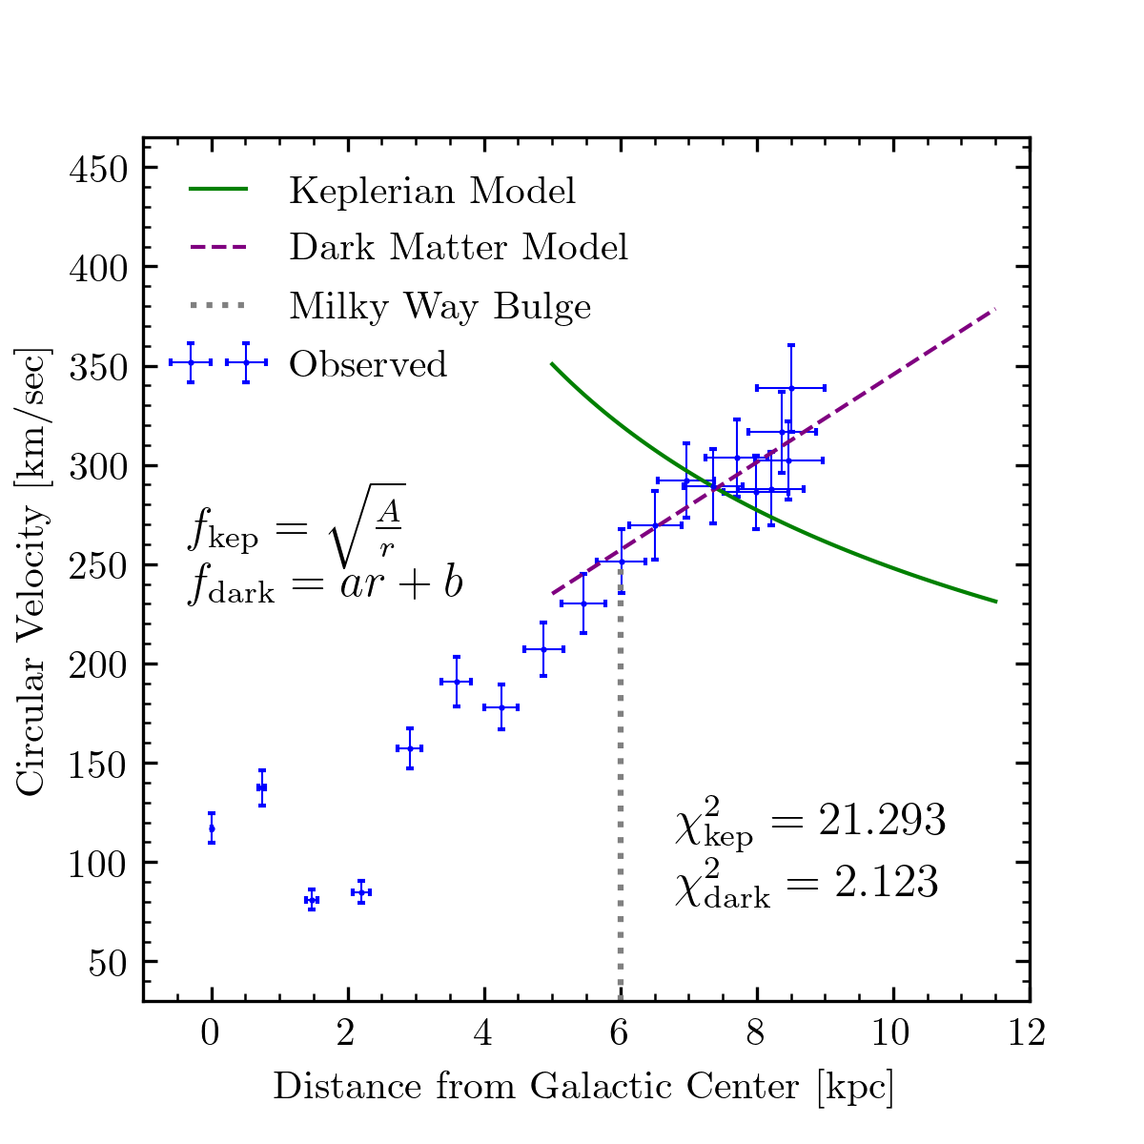
Fitting Velocity Data to Two Models of Rotation

Slide 12
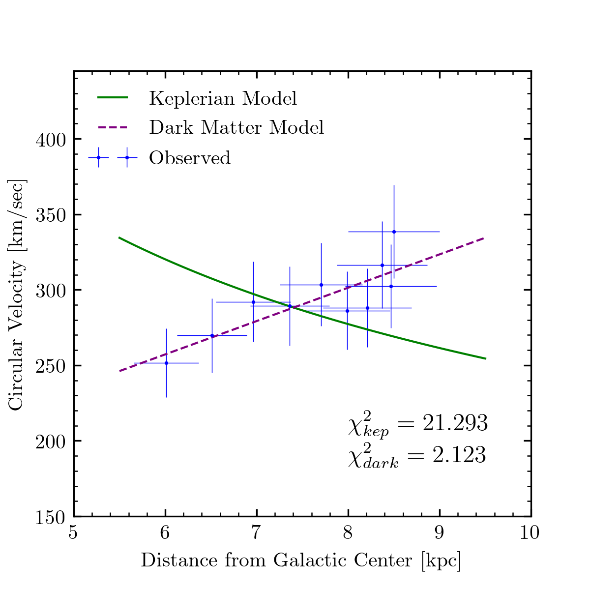
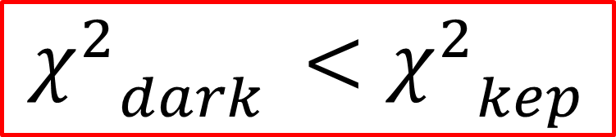
Comparing Rotation Curve Model Fits
$${χ^{2}}_{dark }<{χ^{2}}_{kep}$$

Slide 13
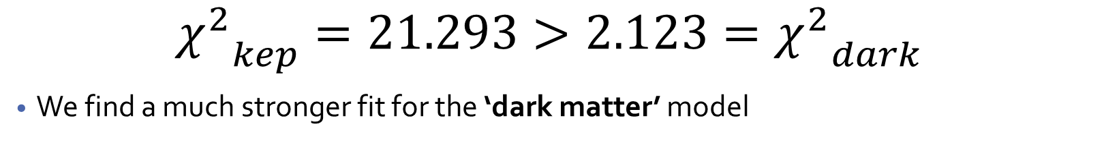
Results and Discussion of Errors
$${χ^{2}}_{kep}=21.293>{{2.123=χ}^{2}}_{dark}$$
We find a much stronger fit for the ‘dark matter’ model
Statistical
Systematic
Not all longitudes scanned as often as others
Fewer sessions of data gathering than desired
Various sources of noise in the galactic plane at different times
Some low-longitude scans performed on longitudes that were partially/becoming invisible due to out of bonds of telescope view
Fit function for red-shift frequency not precisely determined; only by inspection
Days of data taking experienced varying weather

Slide 14
Summary, Conclusion, and Future Steps
What have we accomplished?
Derived an experimental velocity curve for the milky way
Explored its relationship to other models of rotational velocity
Confirmed that a ‘dark matter’ model fits the results better
Showed that 21cm technique is useful for studying the Milky Way
Where can these results lead?
Probing the true mass density of potential dark matter
Constructing the spiral-arm structure of the milky way

Slide 15
Acknowledgements
My lab partner, Luke Gianni, for his collaboration on this project
The 8.13 teaching staff for their instruction and aid in the lab
MIT’s lab facilities and equipment

Slide 16
Thank You!

Slide 17
Appendix A: Data Collecting Scheme
1
2
3
Calibrate the Telescope
Point telescope at a galactic longitude
Average over 20 scans of region for Temperature spectrum
6
5
4
Repeat from 20 to 90 degrees in increments of 10
Fit a signal to results to calculate max red-shift frequency
Fit background model to each spectrum and remove
7
8
9
Calculate velocities and distances from these data
Derive an experimental rotation curve of Milky Way
Compare fits to the two velocity models

Slide 18
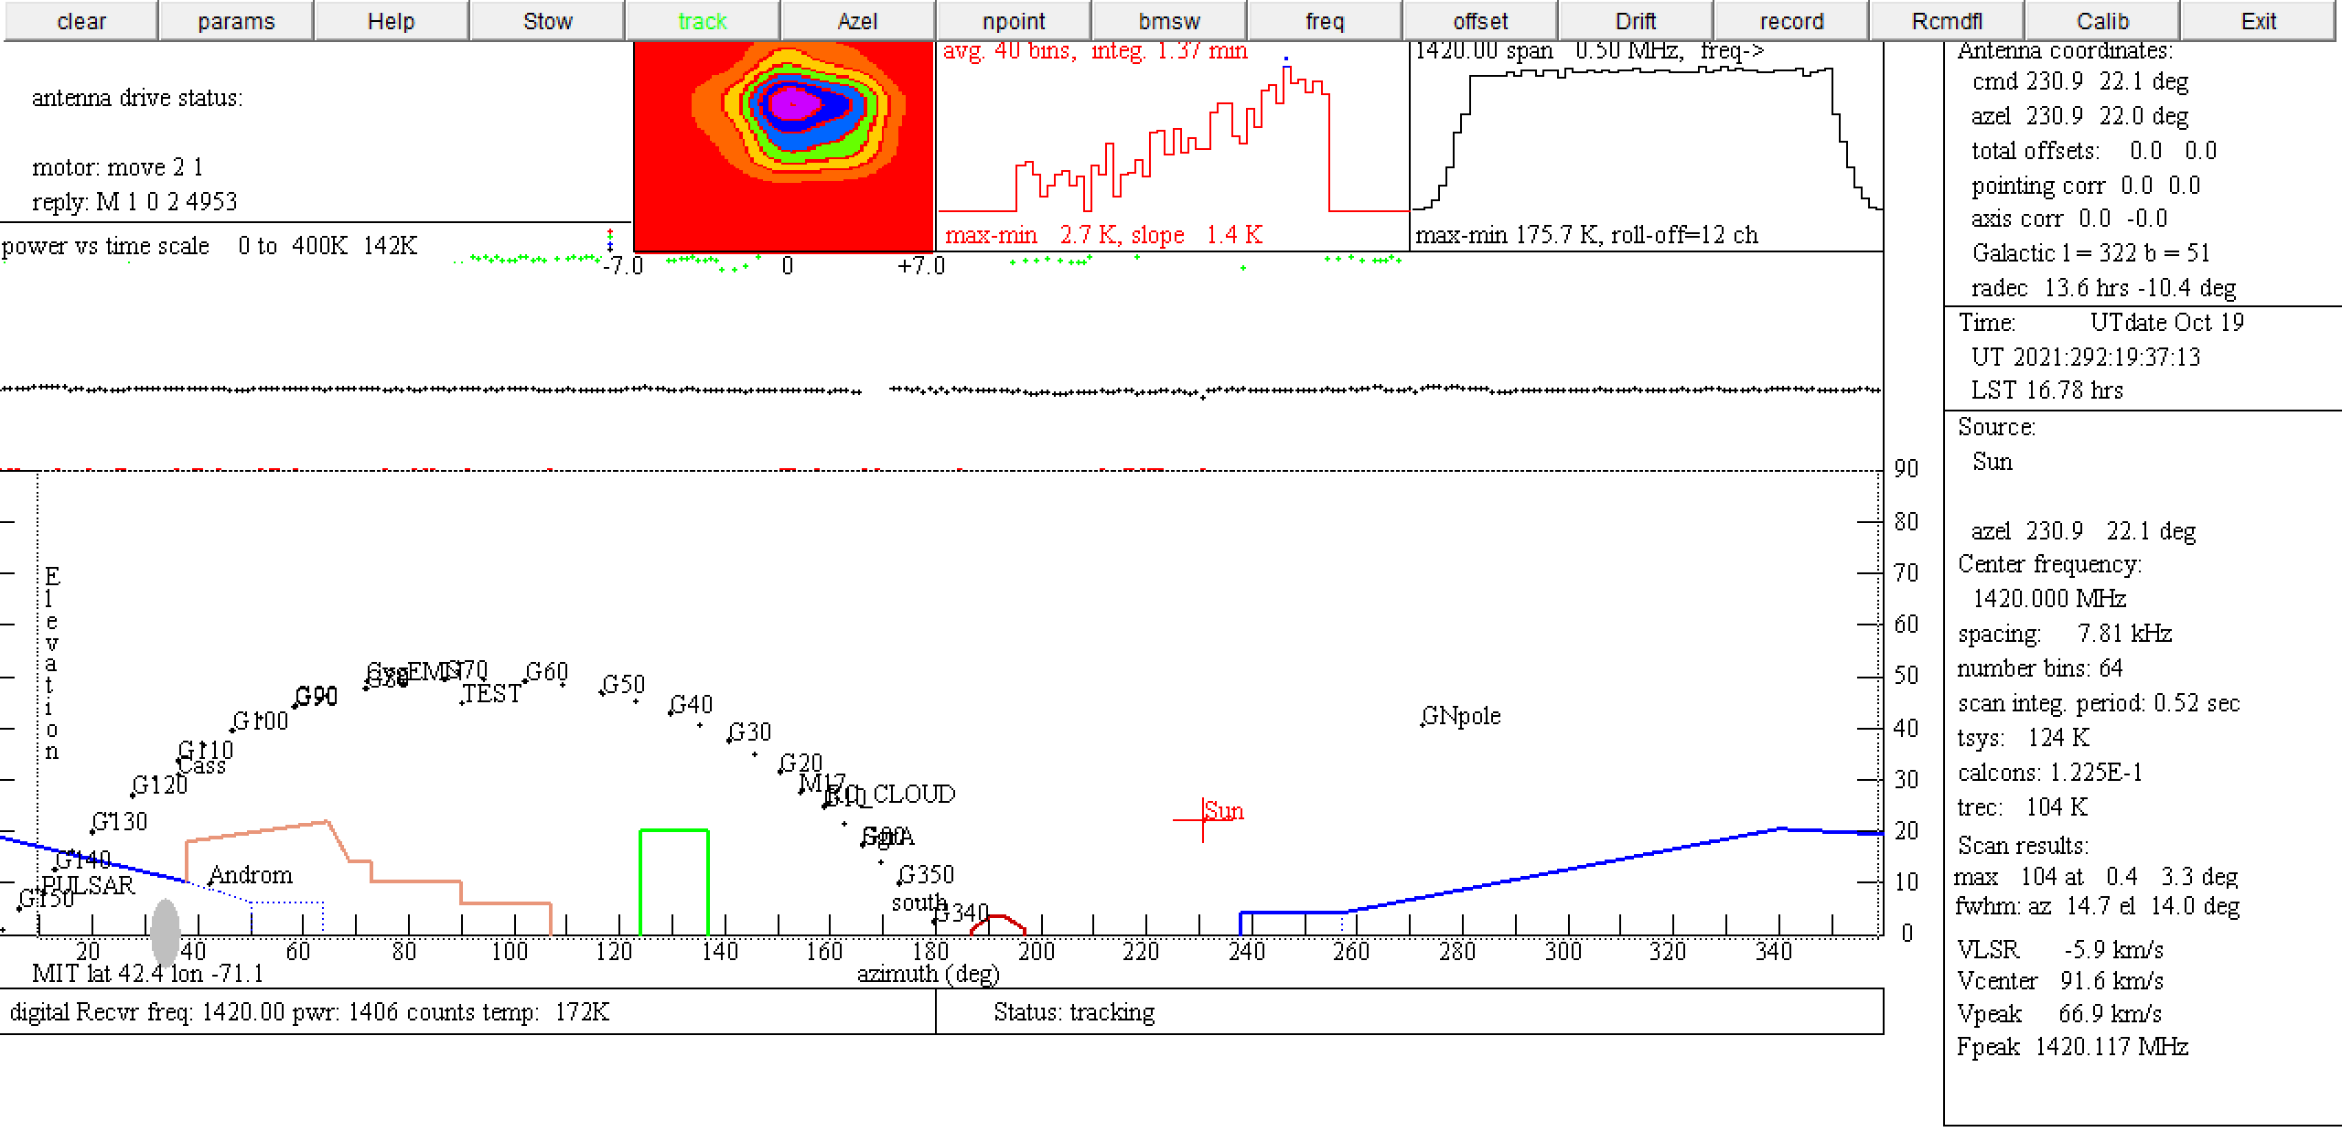
Appendix B: Telescope and Experimental Procedure
Calibration Region
vLSR
Galactic longitudes
Azimuthal axis
Elevation axis

Slide 19
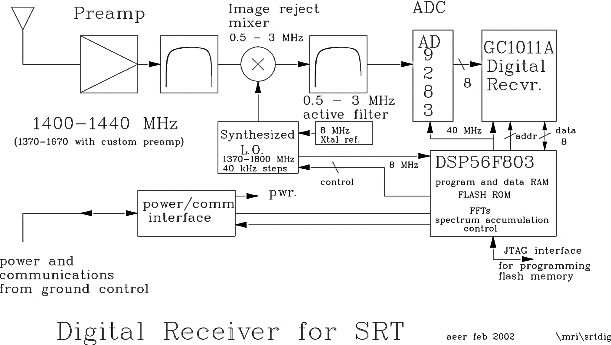
Appendix C: SRT Signal Chain
Band Pass Filter
Keeps signal with difference of frequencies
Modulates signal

Slide 20
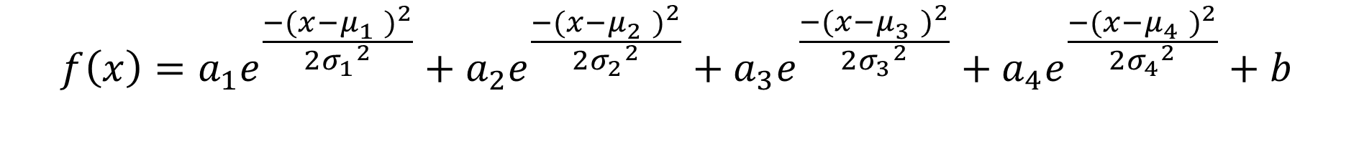
Appendix D: Functional Form for Fitting
$$f\left(x\right)=a_{1}e^{\frac{{−(x−μ_{1}^{})}^{2}}{2{σ_{1}}^{2}}}+a_{2}e^{\frac{{−(x−μ_{2}^{})}^{2}}{2{σ_{2}}^{2}}}+a_{3}e^{\frac{{−(x−μ_{3}^{})}^{2}}{2{σ_{3}}^{2}}}+a_{4}e^{\frac{{−(x−μ_{4}^{})}^{2}}{2{σ_{4}}^{2}}}+b$$

